Slide 1

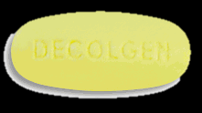
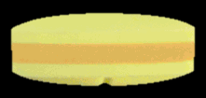

Slide 2
QUESTIONS:
1. Which do you prefer, Generic or branded drugs?
2. what is/are the reason/s why you choose that drug?

Slide 4
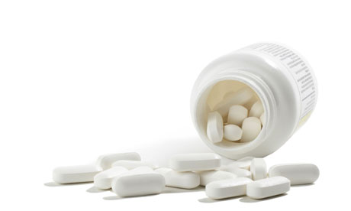
Why Branded?
More effective
High Quality
Reliable
Why Generic?
Affordable

Slide 5
THANK YOU!
ALLOSA, CROMWELL
CAYABYAB, MA. JASEPHINE
ESTRELLA, MIERAFLOR
PENDILLA, ANGEL GRACE
TEPASE, NORIEL LIEZEL ANN
ZOLETA, MARK ERICK

