Slide 1
Gaviscon
Generic or Branded?

Slide 2
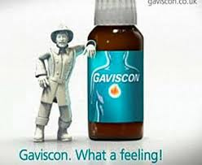
®, all Gaviscon® products contain "alginate". When chewed (Gaviscon® tablets) or swallowed (Gaviscon® liquid), the combination of the alginic acid and bicarbonate creates a foam barrier or "raft" that floats on the stomach acid. This raft foam barrier helps reduce the number of reflux episodes and provides longer lasting action against "heartburn"
than ordinary antacid products. If reflux occurs, this raft foam barrier is the first to contact the esophageal mucosa, and thus provides protection against the acid-pepsin gastric contents. In fact, Gaviscon® helps keep acid down in the stomach, where it belongs.

Slide 3
Percentage

